Slide 1
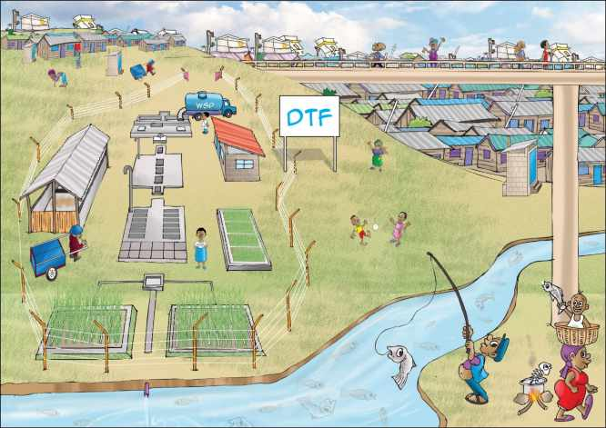
THE DTF CONCEPT

Slide 2
WHAT IS A DTF?
Decentralised Treatment Facility: small scale decentralized plant to treat faecal sludge from dry and wet toilets through mechanical and biological treatment
DTF
Objective
Treat faecal sludge for safe release of the effluent into the environment
Sanigo
Exhauster
Exhauster
UDDT
Pit latrines
Septic tanks
Low Income Area

Slide 3
PURPOSE OF A DTF
1
2
Safe disposal
3
Reuse
Treatment
Mechanical and biological treatment
Safe release of the treated effluent into the environment (water body). Quality of the effluent compliant with national standards
Recycling of
the dry sludge into fertiliser
The treated effluent as water for irrigation

Slide 4
WHAT CAN BE TREATED OR NOT?
TREATED
NOT TREATED
Faecal sludge (septage) emptied and transported by exhauster trucks from septic tanks or latrines
(partly) dried faecal matter from UDDTs emptied and transported by Sanigo
Waste water generated in flush toilets and conveyed through a sewer network
Grey water (from laundry, shower, kitchen) due to low organic loads that would negatively affect the treatment performance of the DTF and saturate the capacity of the DTF too quickly
Storm water for the same reason as grey water

Slide 5
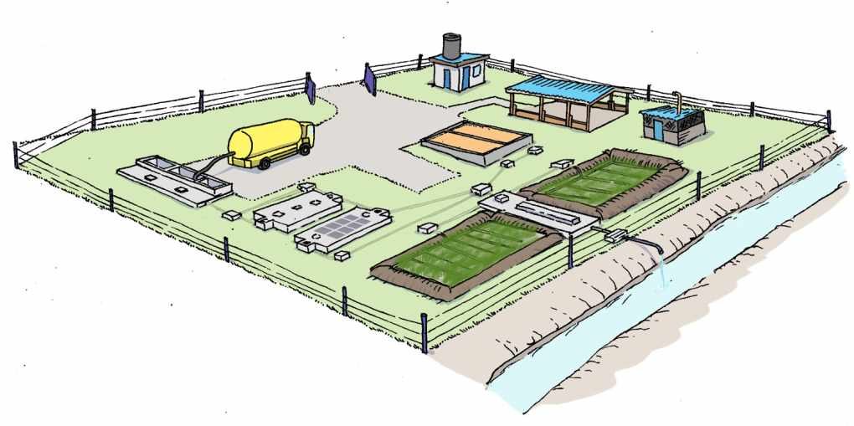
DTF MODULES
6
Operator Store
Sludge Drying Beds
7
Composting Area
5
Receiving Bay / Balancing Tank
Incinerator
1
8
2
Settler
3
Anaerobic Baffled Reactor
4
Vertical Flow Constructed Wetland

Slide 6
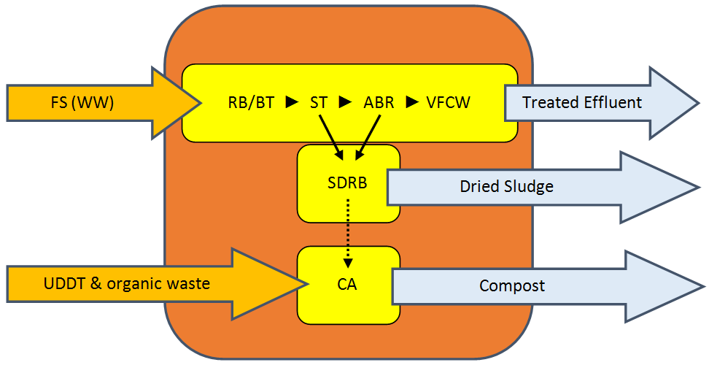
DTF TREATEMENT
NO CHEMICALS !!
→ Mechanical and biological treatment
NO ELECTRICITY !!
→ DTF runs by gravity

Slide 7
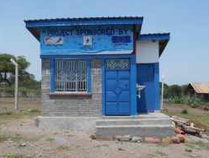
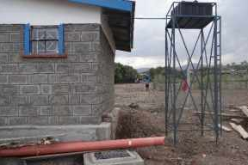
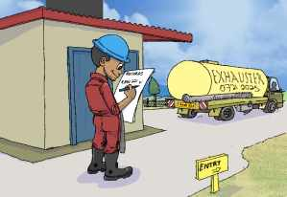
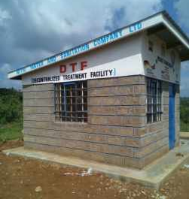
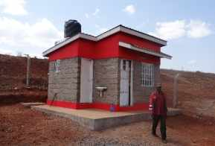
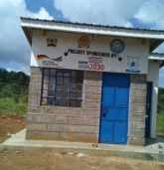
IN DETAILS
Operator Store
Operator’s office (equipped with toilet, sink and shower)
Entrance registration desk
Storage room for equipment

Slide 8
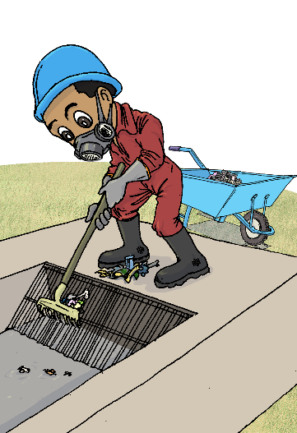
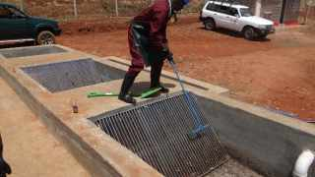
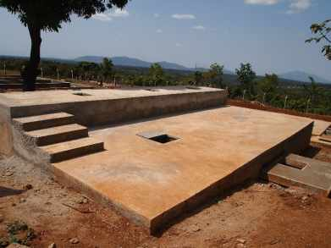
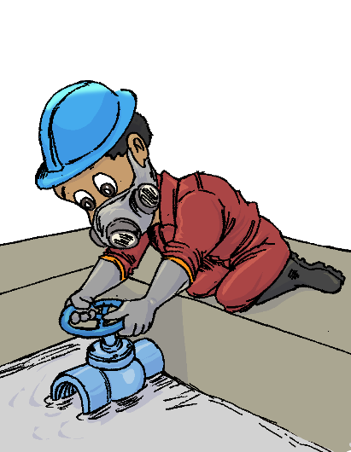
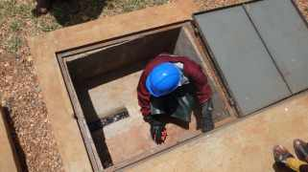
IN DETAILS
Receiving Bay / Balancing Tank
Screening of the coarse material
Storage of the effluent
Flow control to provide constant inflow to the DTF

Slide 9
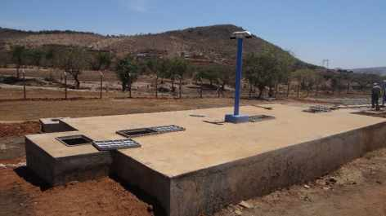
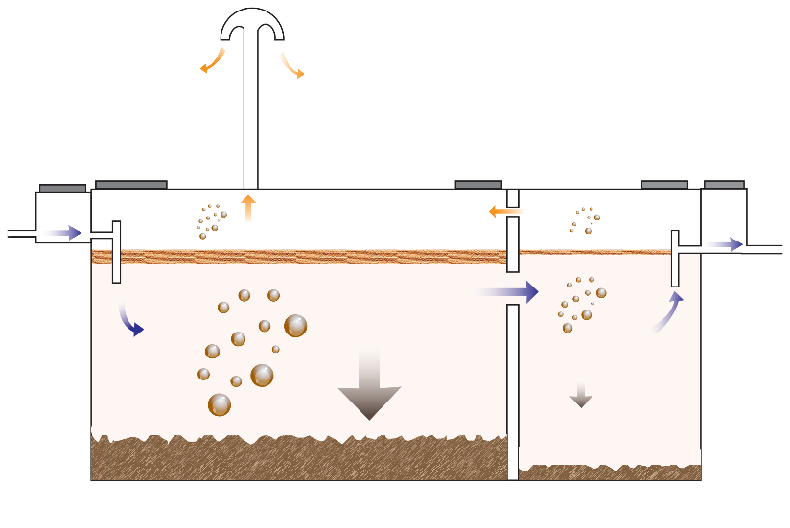
IN DETAILS
Settler
2 consecutive chambers separated with a baffle wall
Sedimentation of settable solid
Flotation of fat and oil

Slide 10
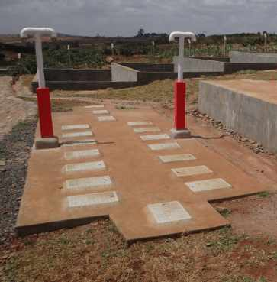
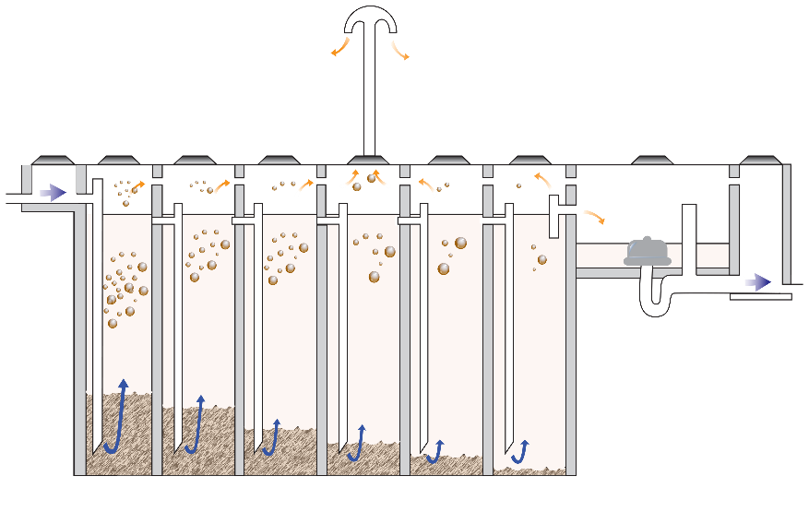
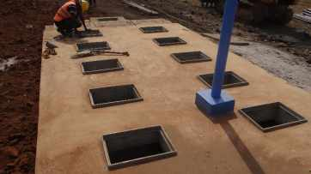
IN DETAILS
Anaerobic Baffled Reactor (ABR)
2 rows of 6 consecutive chambers with down pipes → anaerobic treatment through the settled sludge
1 siphon chamber → to release intermittent flow

Slide 11
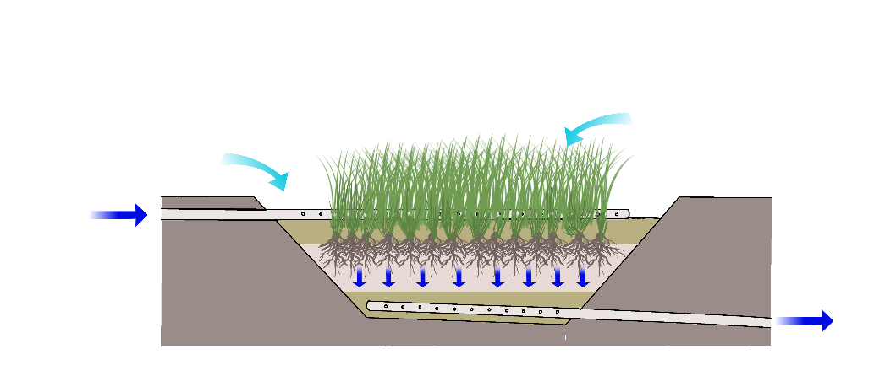
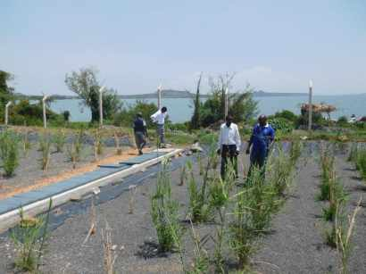
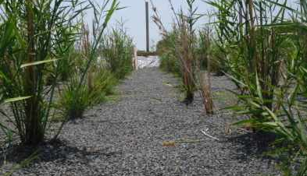
IN DETAILS
Vertical Flow Constructed Wetland (VFCW)
2 basins filled with successive gravel and sand layers planted with aquatic plants
Perforated pipes on top (to feed) and at the bottom (to receive)
Intermittent feed to enable intake of oxygen
Filtration and sedimentation
Anaerobic and anaerobic treatment
O₂
O₂

Slide 12
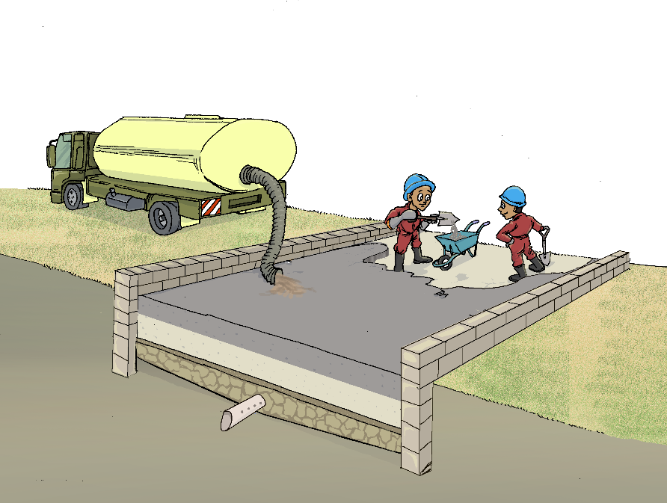
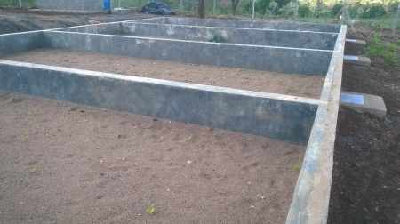
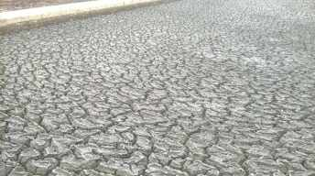
IN DETAILS
Sludge Drying Beds (SDB)
2 non planted beds filled with successive gravel and sand layers
1 underdrain pipe at the bottom draining the leachate to the next treatment module
Filtration and dehydration (evaporation)

Slide 13
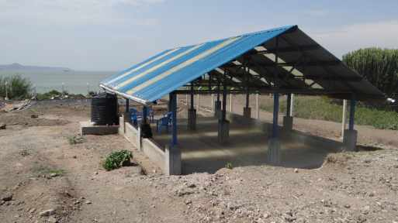
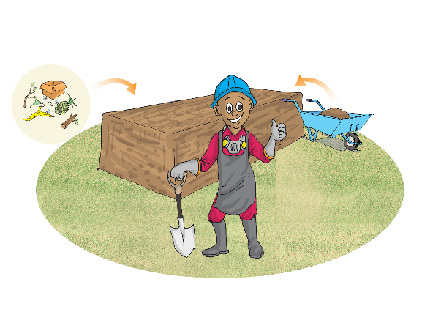
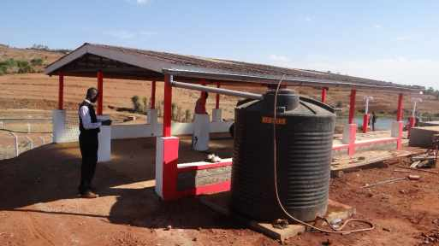
IN DETAILS
Composting Area
Composting shed with partly translucent roofing
Mix dry sludge and organic waste to produce compost
After 12 weeks of appropriate mixing, turning and watering
→ mature and safe compost

Slide 14
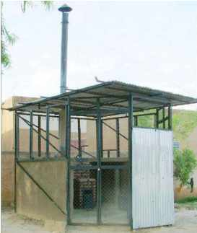
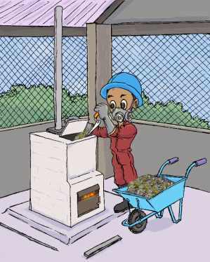
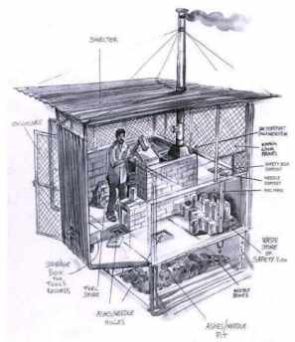
IN DETAILS
Waste Disposal Unit
Comprises of an incinerator, a 4m high chimney, a waste store and a shelter for protection against the rain
Solid waste screened in the Receiving Bay is incinerated at a temperature of 600°C

